Slide 1
Follow the Rules: Efficient Optimization-based Motion Planning for Autonomous Vehicles
Mo Chen
Technical University of Munich
03.07.2023

Slide 2
Content
1. Introduction
2. Signal Temporal Logic
3. Successive Convexification
4. Experiments

Slide 3
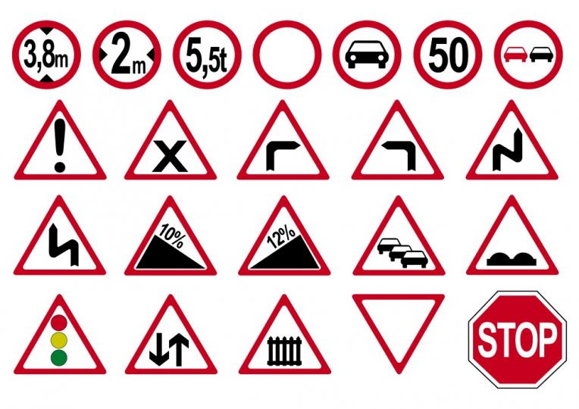
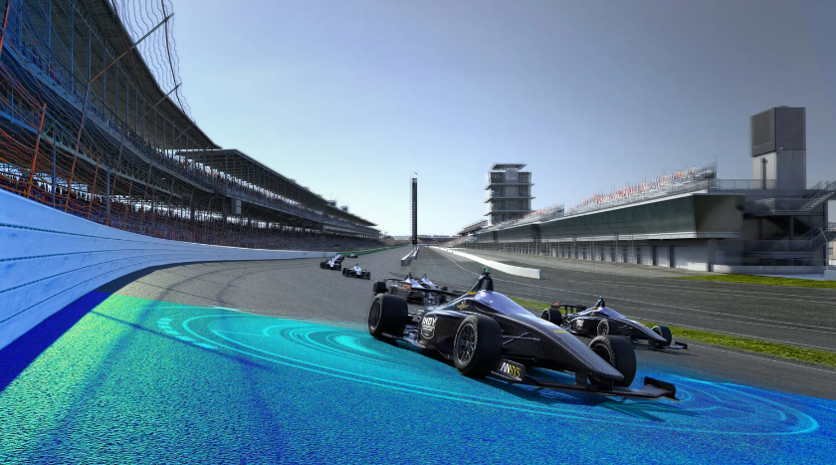
Introduction
Challenges in Autonomous Driving:
1. Complex traffic rules
Signal Temporal Logic
2. Real-time capability
Efficient Optimization-based
Motion Planning
Source: https://www.expatrio.com/living-germany/driving-germany
https://www.mos.ed.tum.de/en/ftm/main-research/intelligent-vehicle-systems/indy-autonomous-challenge/

Slide 4
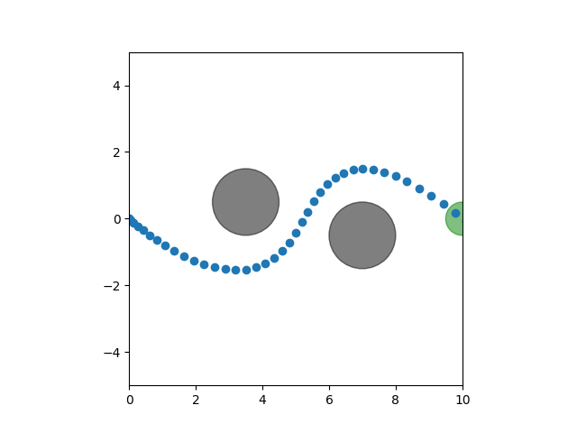
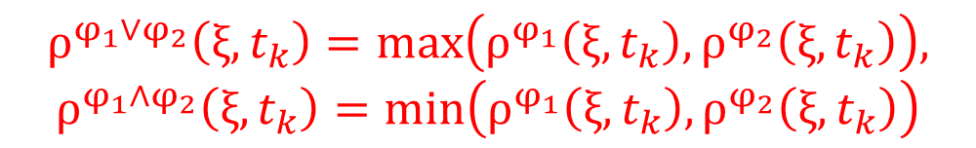
Signal Temporal Logic
Temporal operators
STL formulas[1]:
Obstacles
Trajectory
$$φ:=π^{μ}\left|¬φ\right|φ_{1}∧φ_{2}\left|φ_{1}∨φ_{2}\right|F_{\left[a,b\right]}φ\left|G_{\left[a,b\right]}φ\right|φ_{1}U_{\left[a,b\right]}φ_{2}$$
Goal region
Atomic predicate
Disjunction
Always
Conjunction
Eventually
Negation
Until
Determine the satisfaction/violation of STL formula
1. Qualitative: Boolean result
2. Quantitative: robustness function
(positive satisfaction)
$$ρ^{φ_{1}∨φ_{2}}\left(ξ,t_{k}\right)=\text{m}\text{ax}\left(ρ^{φ_{1}}\left(ξ,t_{k}\right),ρ^{φ_{2}}\left(ξ,t_{k}\right)\right),$$
$$ρ^{φ_{1}∧φ_{2}}\left(ξ,t_{k}\right)=\text{m}\text{in}\left(ρ^{φ_{1}}\left(ξ,t_{k}\right),ρ^{φ_{2}}\left(ξ,t_{k}\right)\right)$$
[1] Belta, Calin, and Sadra Sadraddini. "Formal methods for control synthesis: An optimization perspective." Annual Review of Control, Robotics, and Autonomous Systems 2 (2019): 115-140.

Slide 5
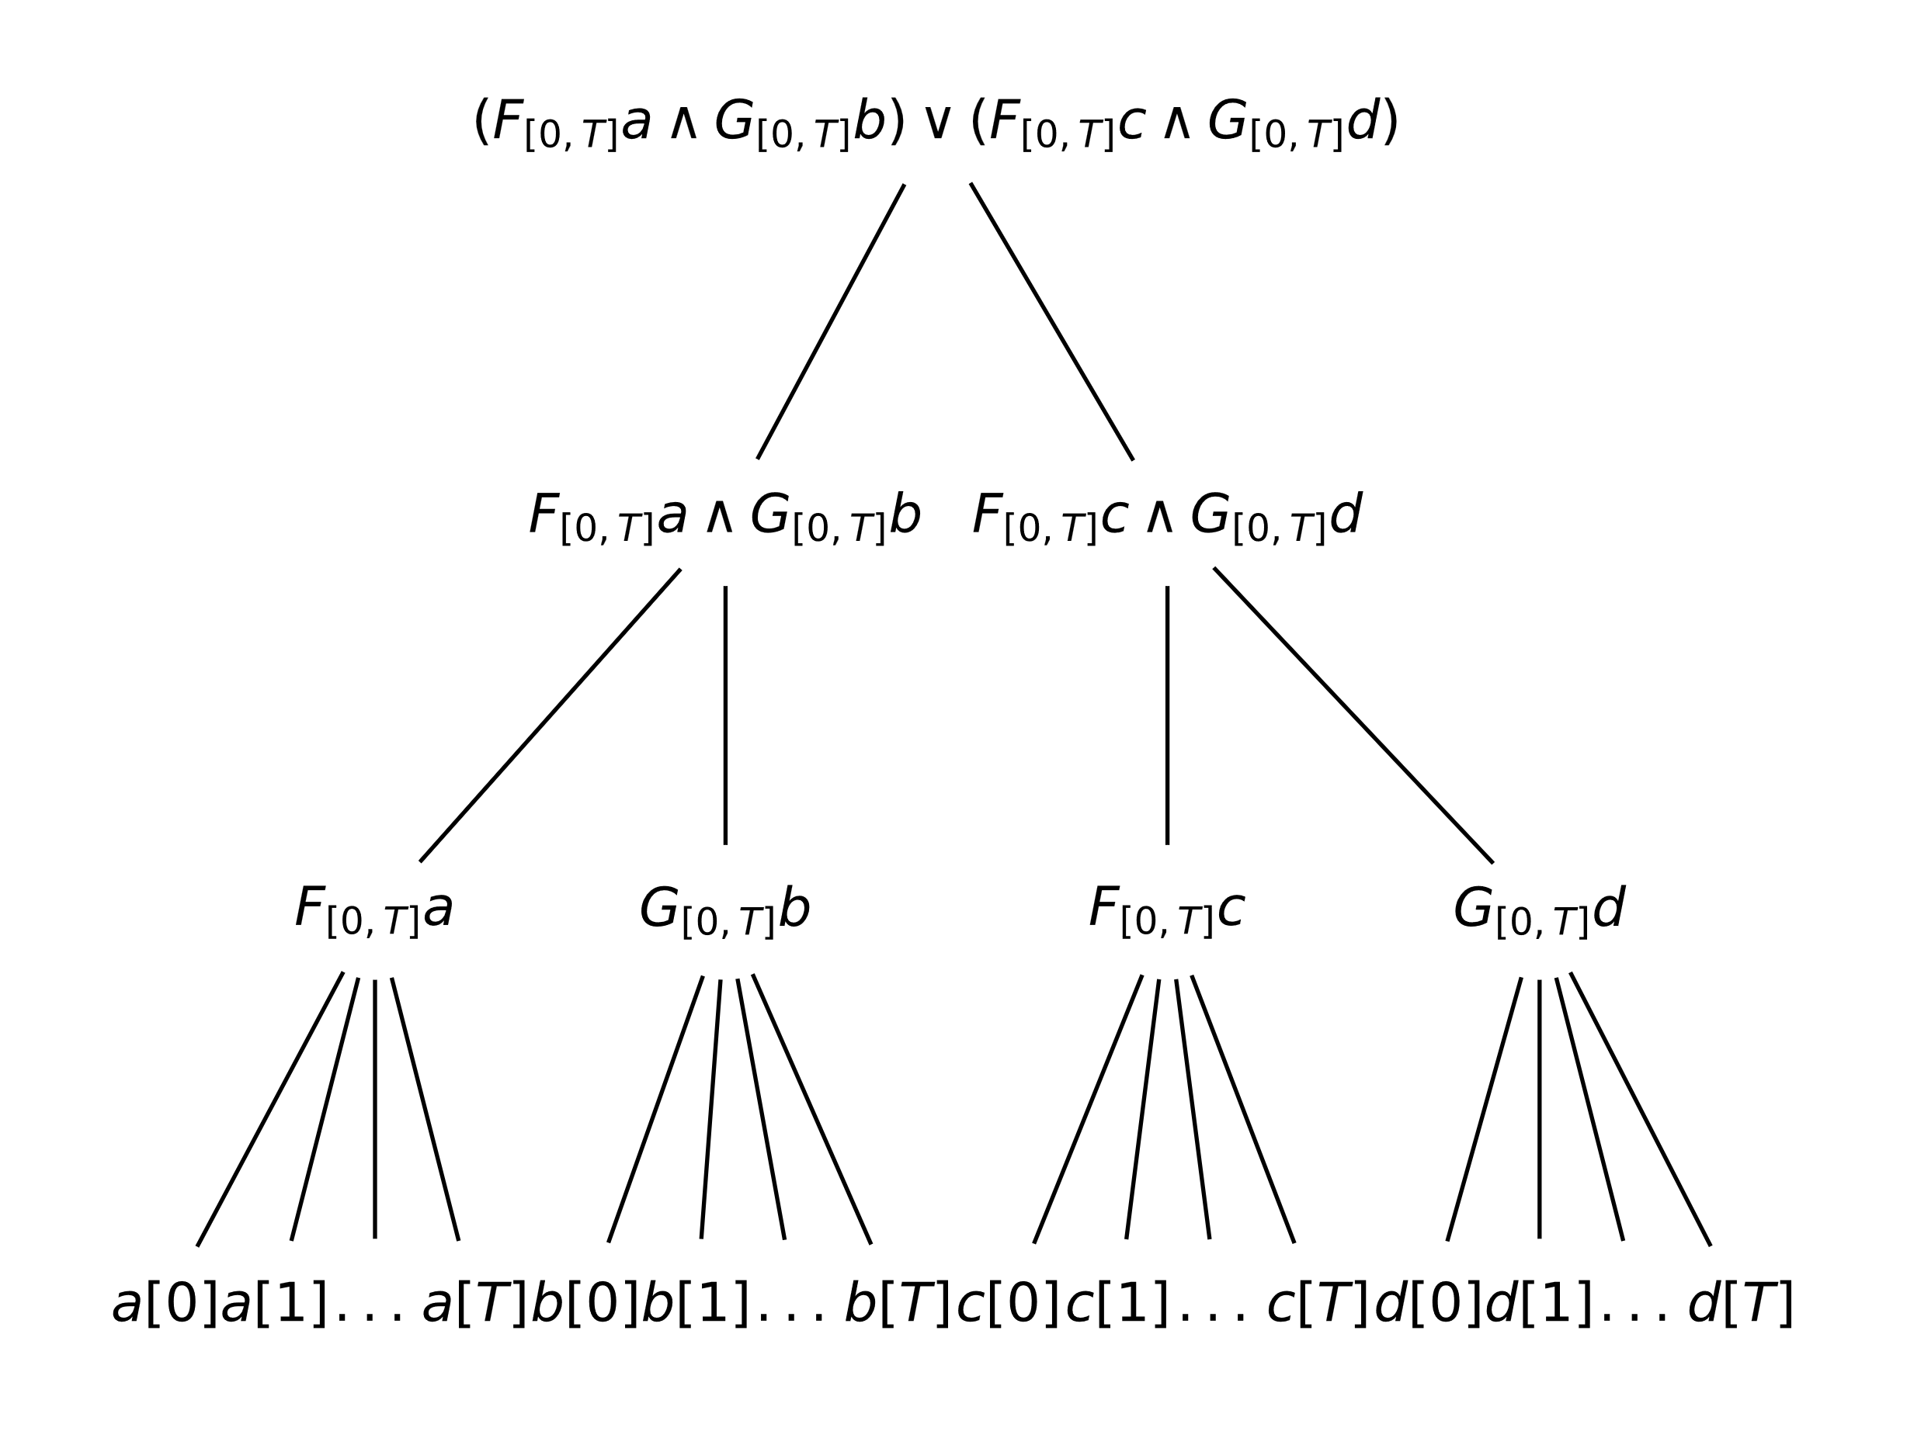
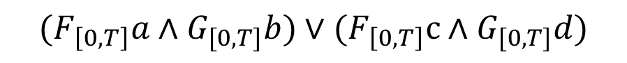
Signal Temporal Logic
STL formula STL tree[2]
$$(F_{\left[0,T\right]}a∧G_{[0,T]}b)∨(F_{\left[0,T\right]}c∧G_{[0,T]}d)$$
[2] Kurtz, Vincent, and Hai Lin. "Mixed-integer programming for signal temporal logic with fewer binary variables." IEEE Control Systems Letters 6 (2022): 2635-2640.

Slide 6
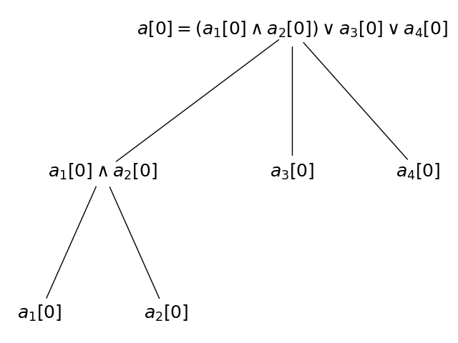
Signal Temporal Logic
Its robustness>0
Before temporal operators
After
temporal operators
Temporal operators
Atomic predicates

Slide 7
Signal Temporal Logic – An Existing encoding Method
Introduce binary variables on
atomic predicates(MICP)[1] or
disjunctions(SOS1)[2].
A common solving method
Mixed-Integer Programming
NP-hard problem
Lose real-time capability

Slide 8
Signal Temporal Logic – Another encoding Method
max
max
Use some continuous approximation functions to replace min/max functions
min
min
min
max
min
max
min

Slide 9
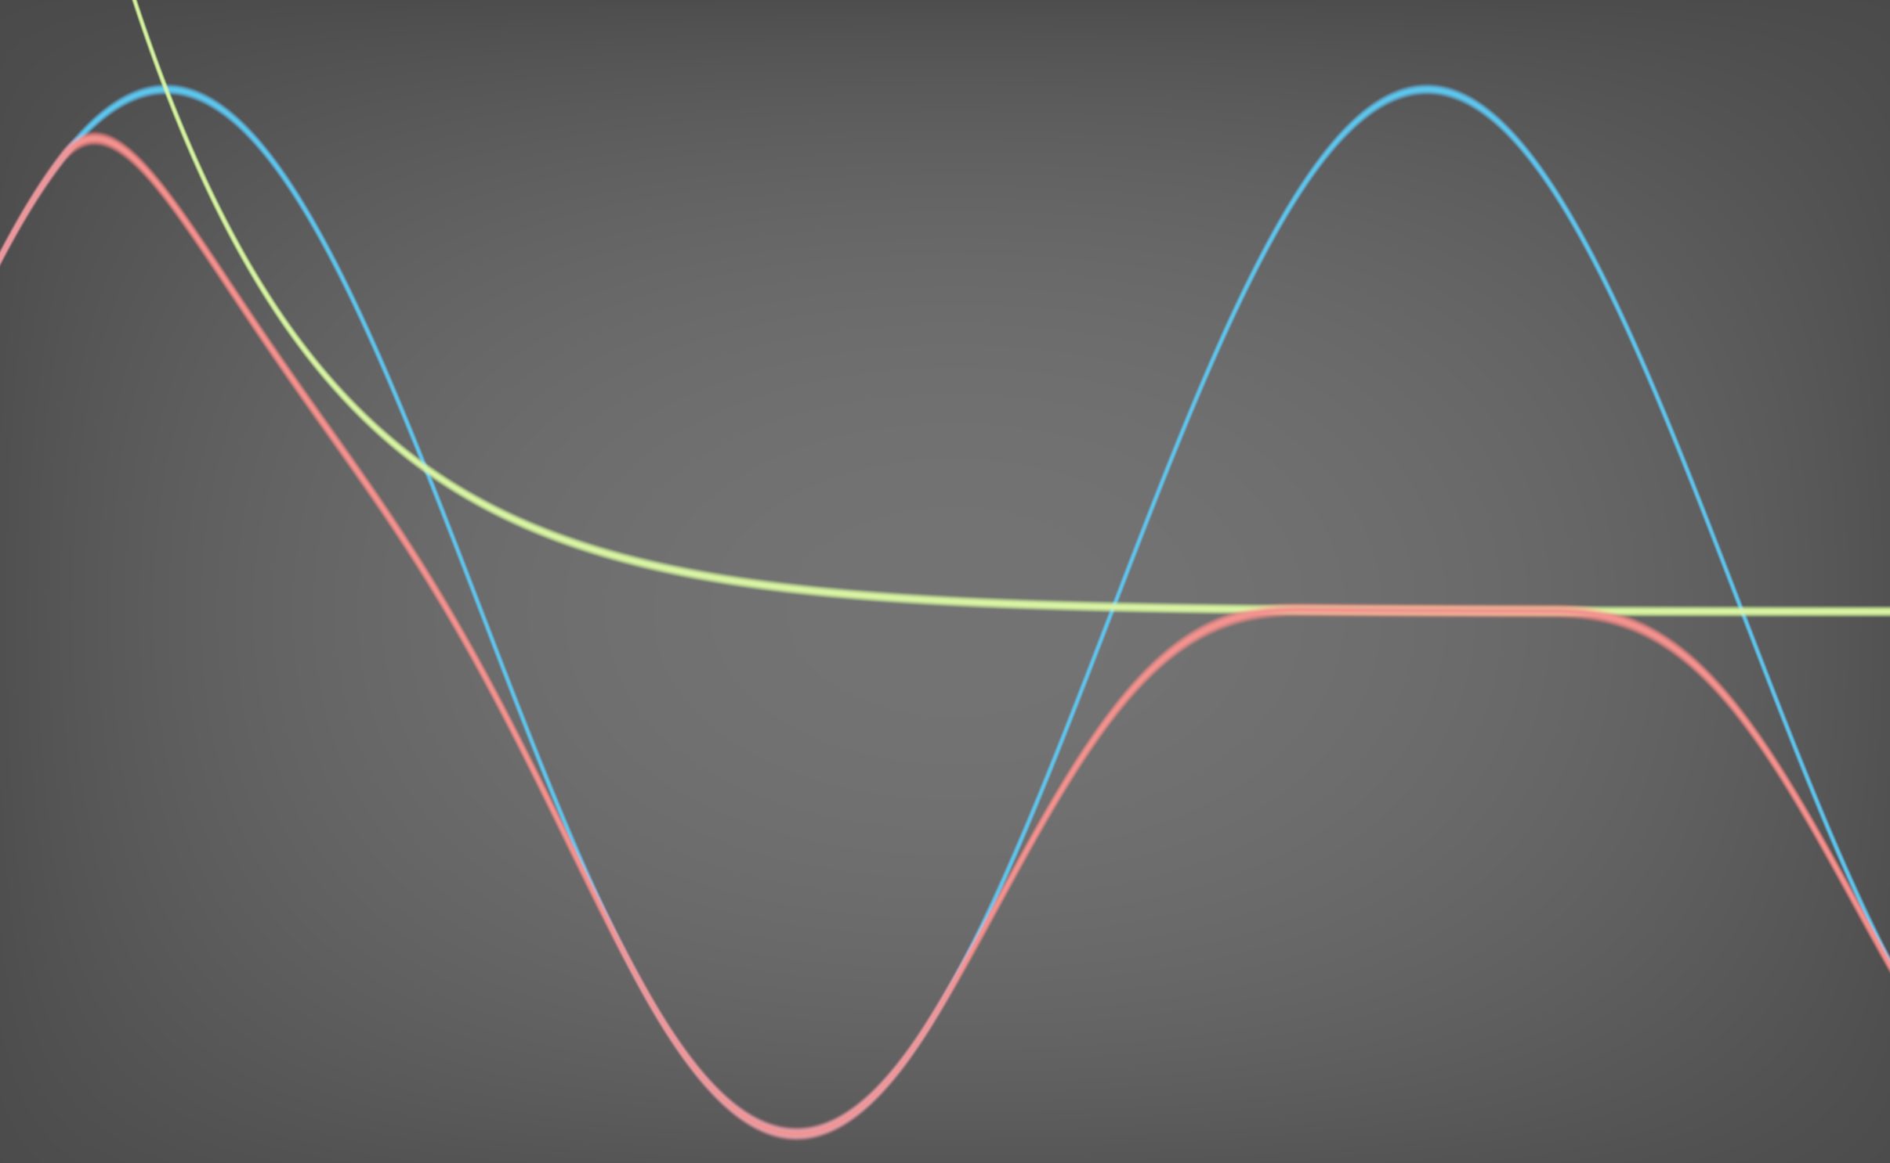
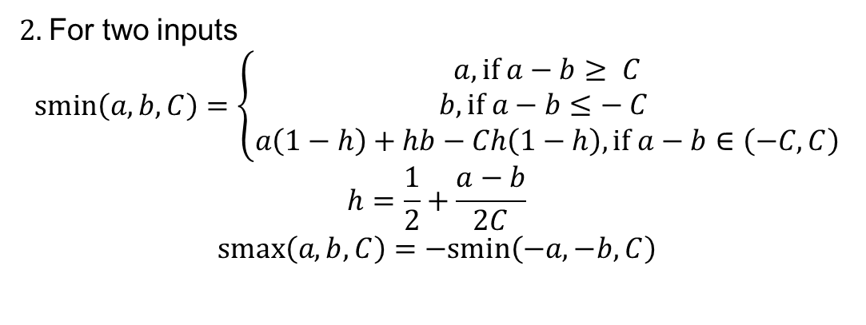
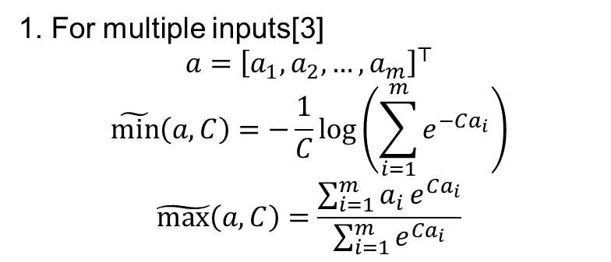
Signal Temporal Logic – Approximation min/max
1. For multiple inputs[3]
$$a={\left[a_{1},a_{2},…,a_{m}\right]}^{⊤}$$
$$\tilde{\text{min}}\left(a,C\right)=−\frac{1}{C}\text{log}\left(\sum_{i=1}^{m}{e^{−Ca_{i}}}\right)$$
$$\tilde{\text{max}}\left(a,C\right)=\frac{\sum_{i=1}^{m}{a_{i}}e^{Ca_{i}}}{\sum_{i=1}^{m}{e^{Ca_{i}}}}$$
2. For two inputs
$$\text{smin}\left(a,b,C\right)=\left\{\begin{aligned}a, if a−b≥ C \\ b,if a−b≤− C \\ a\left(1−h\right)+hb−Ch\left(1−h\right),if a−b∈\left(−C,C\right)\end{aligned}\right.$$
$$h=\frac{1}{2}+\frac{a−b}{2C}$$
$$\text{smax}\left(a,b,C\right)=−\text{smin}\left(−a,−b,C\right)$$
Source: https://www.shadertoy.com/view/Ml3Gz8
[3] Gilpin, Yann, Vince Kurtz, and Hai Lin. "A smooth robustness measure of signal temporal logic for symbolic control." IEEE Control Systems Letters 5.1 (2020): 241-246.

Slide 10

Signal Temporal Logic – Our encoding Method
Its robustness>0
Different functions as inputs
max
max
Use $\tilde{\text{m}in}$ / $\tilde{\text{max}}$
min
min
min
max
min
max
min
Same functions as inputs
Iteratively use smin/smax

Slide 11
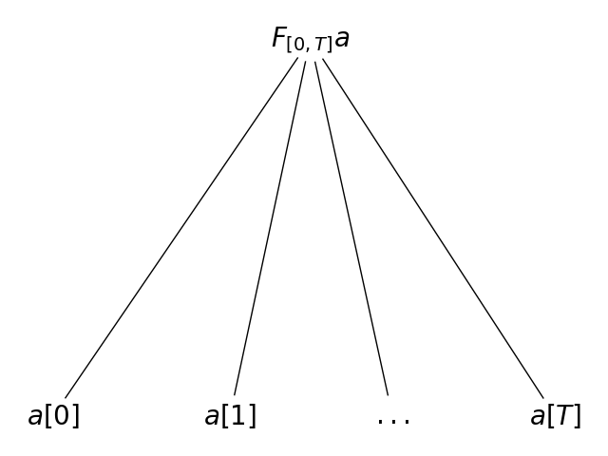
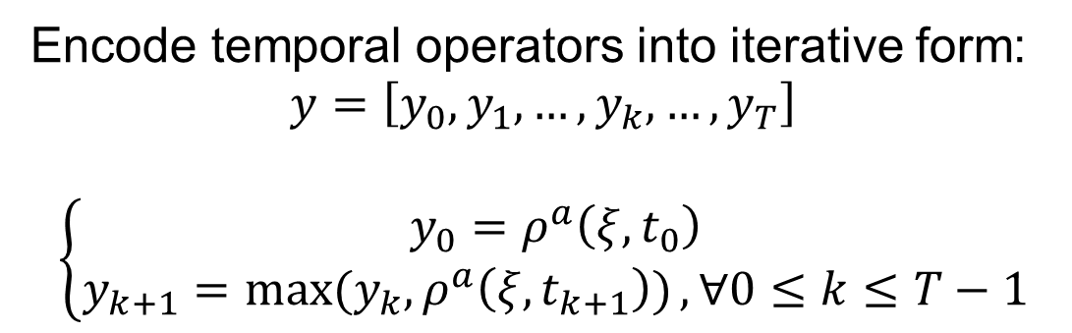



Signal Temporal Logic – Our encoding Method
Encode temporal operators into iterative form:
$$y=\left[y_{0},y_{1},…,y_{k},…,y_{T}\right]$$
$$\left\{\begin{aligned}y_{0}=ρ^{a}\left(ξ,t_{0}\right) \\ y_{k+1}=\max{(y_{k}, ρ^{a}\left(ξ,t_{k+1}\right))},∀0≤k≤T−1\end{aligned}\right.$$
$$y_{0}$$
$$y_{1}$$
$$y_{T}$$

Slide 12
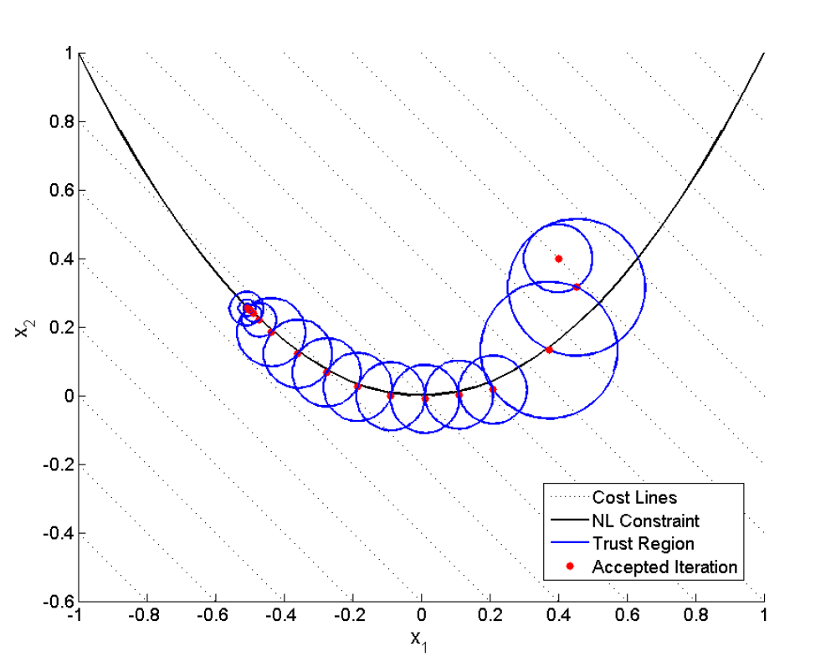
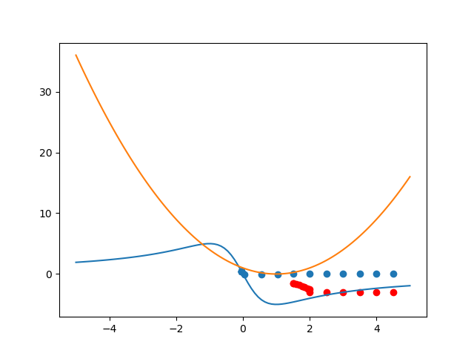
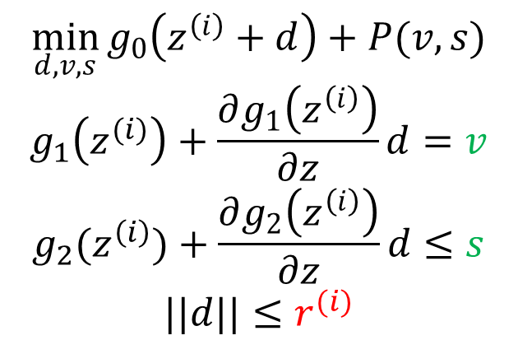
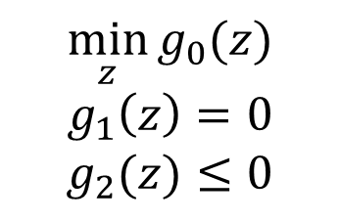
Successive Convexification[4]
$$\min_{z}{g_{0}(z)}$$
$$g_{1}\left(z\right)=0$$
$$g_{2}(z)≤0$$
$$\min_{d,v,s}{g_{0}\left(z^{\left(i\right)}+d\right)+P(v,s)}$$
$$g_{1}\left(z^{(i)}\right)+\frac{∂g_{1}\left(z^{\left(i\right)}\right)}{∂z}d=v$$
$$g_{2}(z^{\left(i\right)})+\frac{∂g_{2}\left(z^{\left(i\right)}\right)}{∂z}d≤s$$
$$||d||≤r^{(i)}$$
Linearize
Start point
Trust region radius
Virtual control inputs
Feasible set
Two different start points
Typical convergence process with virtual control and trust regions[5]
Infeasible solution
Different initial guesses lead to different solutions
[4] Mao, Yuanqi, et al. "Successive convexification: A superlinearly convergent algorithm for non-convex optimal control problems." arXiv preprint arXiv:1804.06539 (2018).
[5] Mao, Yuanqi, Michael Szmuk, and Behçet Açıkmeşe. "Successive convexification of non-convex optimal control problems and its convergence properties." 2016 IEEE 55th Conference on Decision and Control (CDC). IEEE, 2016.

Slide 13
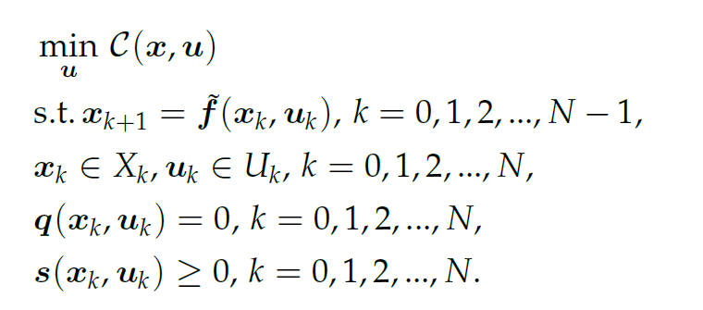
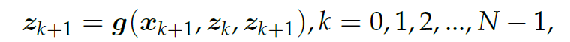
Successive Convexification – Signal Temporal Logic
Original trajectory planning problem
Add STL formula
Encode STL formula into iterative form
Apply successive convexification(SCvx)

Slide 14
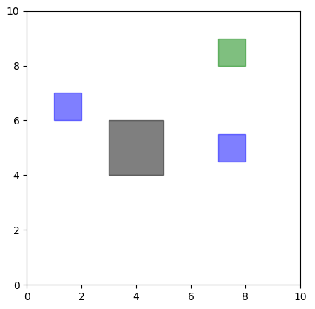
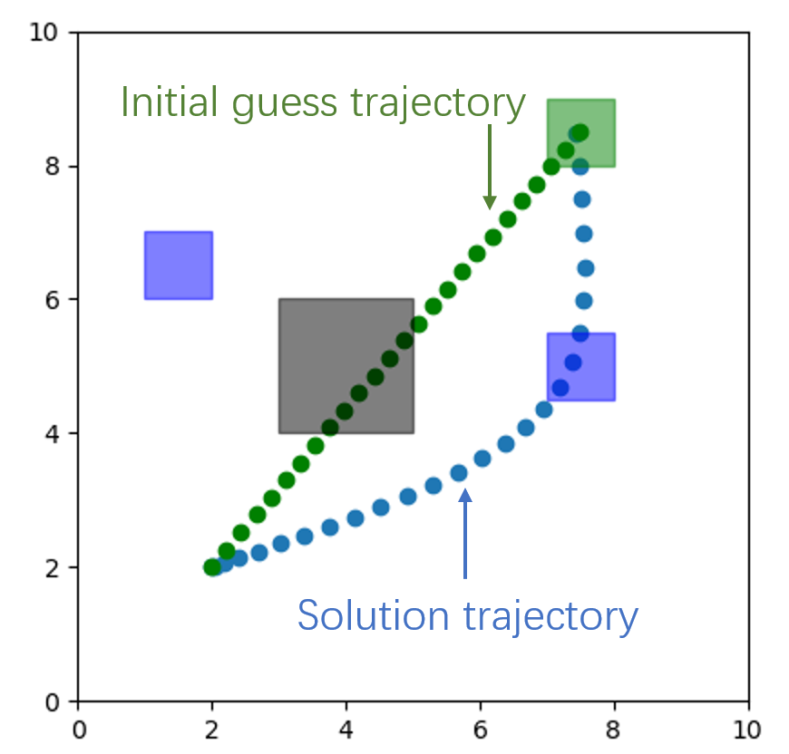
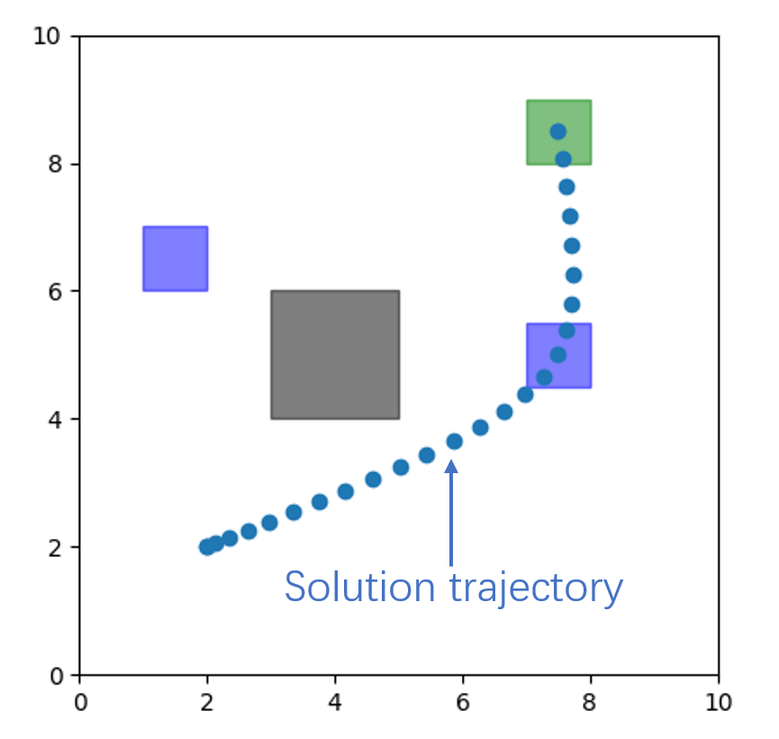
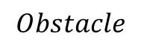

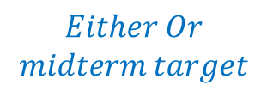
Experiments – “Either Or”[2]
Pass through one of two blue target and reach the goal
$$Final target$$
$$Obstacle$$
$$Either Or$$
$$midterm target$$
Task
Our solution
MICP/SOS1

Slide 15
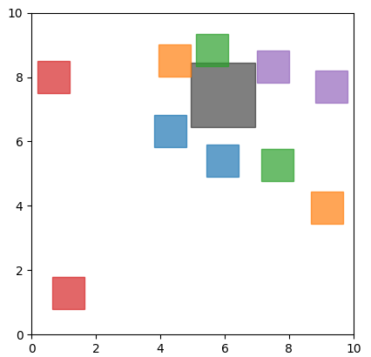
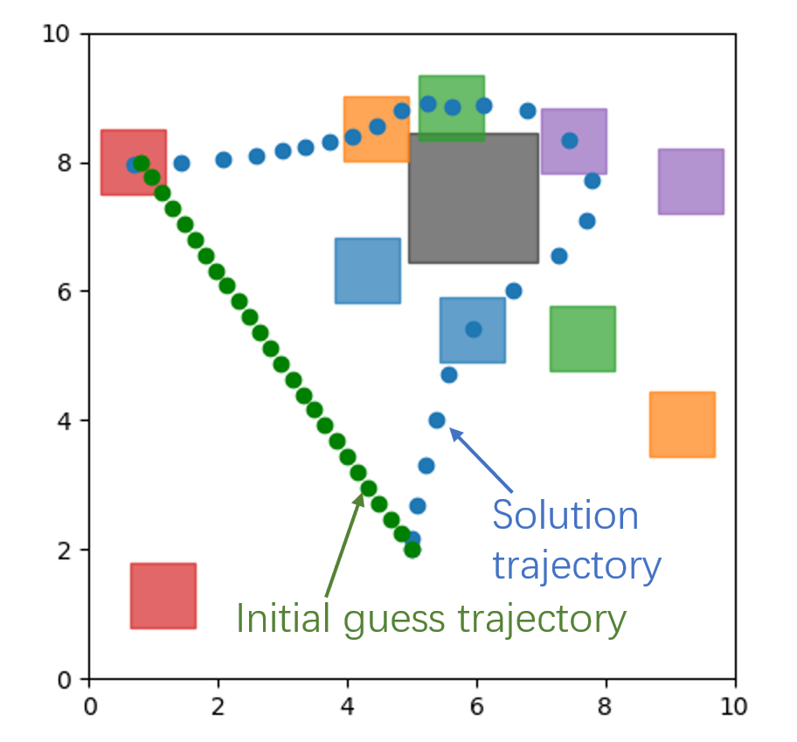
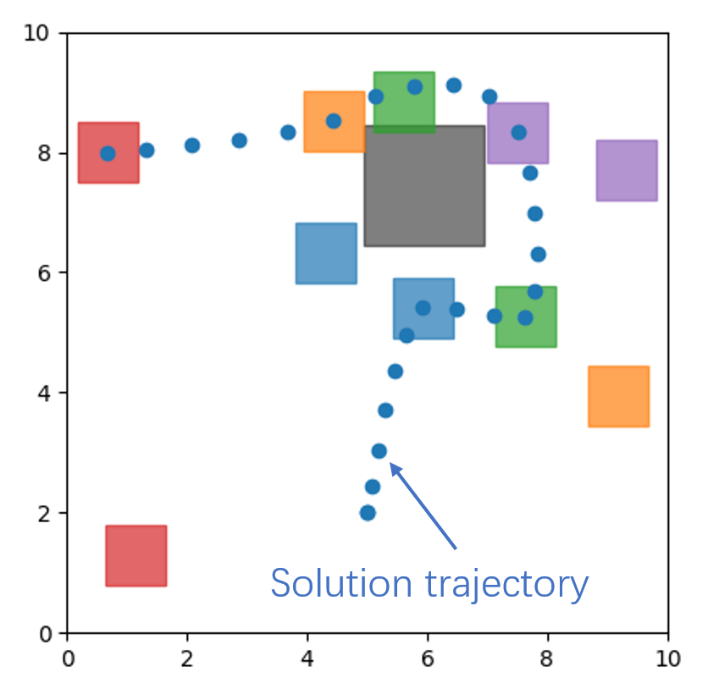
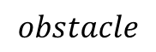
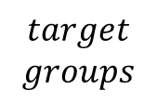
Experiments – “Multitask”[2]
Pass through at least one of the colorful areas in each target group
$$obstacle$$
$$target$$
$$groups$$
Task
Our solution
MICP/SOS1

Slide 16
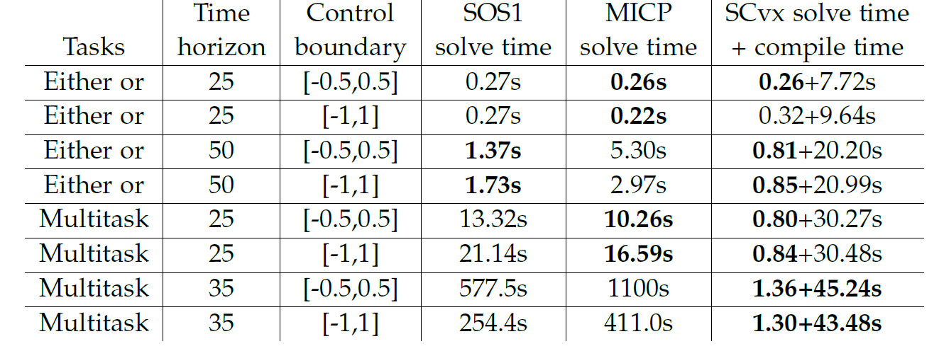
Experiments
Solve time of solvers for "Either or" and "Multitask".
Good results - solve time of SCvx
is small
polynomial increases with the time horizon
Bad results - compile time of SCvx is long.
Reasons:
Unnecessary check for convexity
Use CVXPY[6] and ECOS[7]
[6] Diamond, Steven, and Stephen Boyd. "CVXPY: A Python-embedded modeling language for convex optimization." The Journal of Machine Learning Research 17.1 (2016): 2909-2913.
[7] Domahidi, Alexander, Eric Chu, and Stephen Boyd. "ECOS: An SOCP solver for embedded systems." 2013 European control conference (ECC). IEEE, 2013.

Slide 17
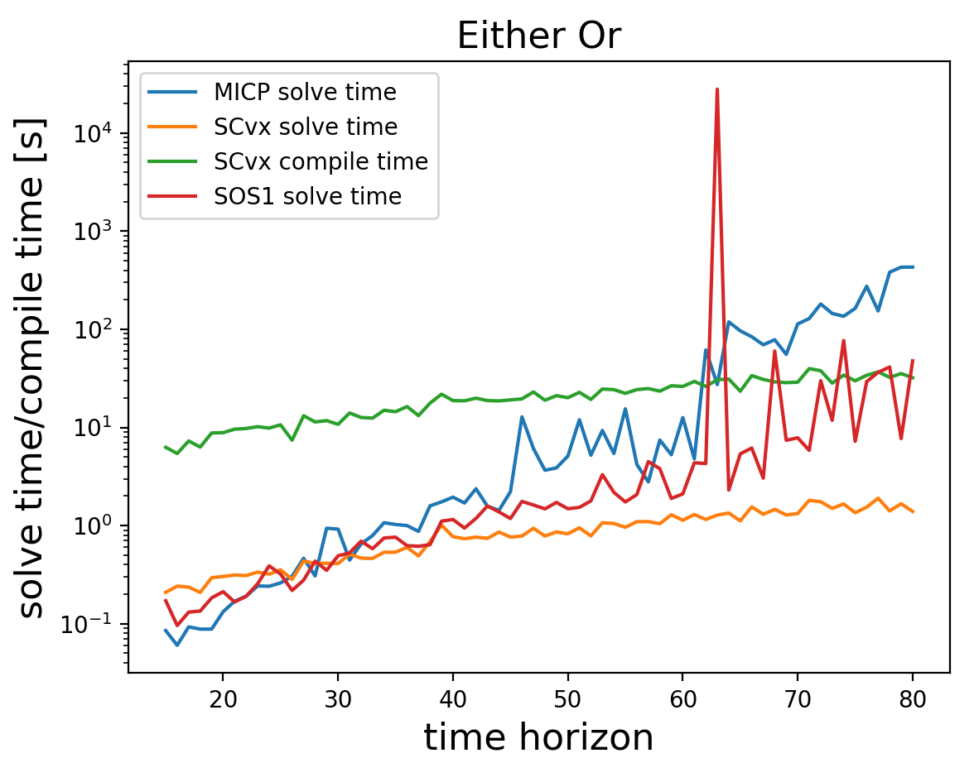
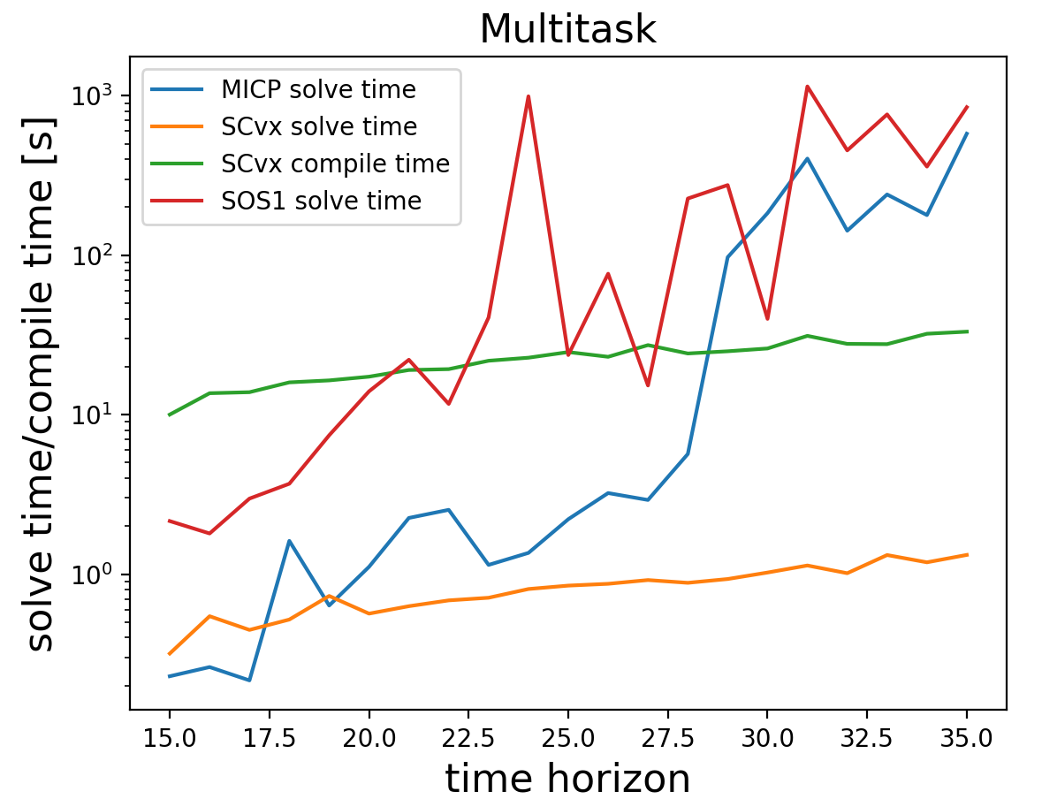
Experiments

Slide 18
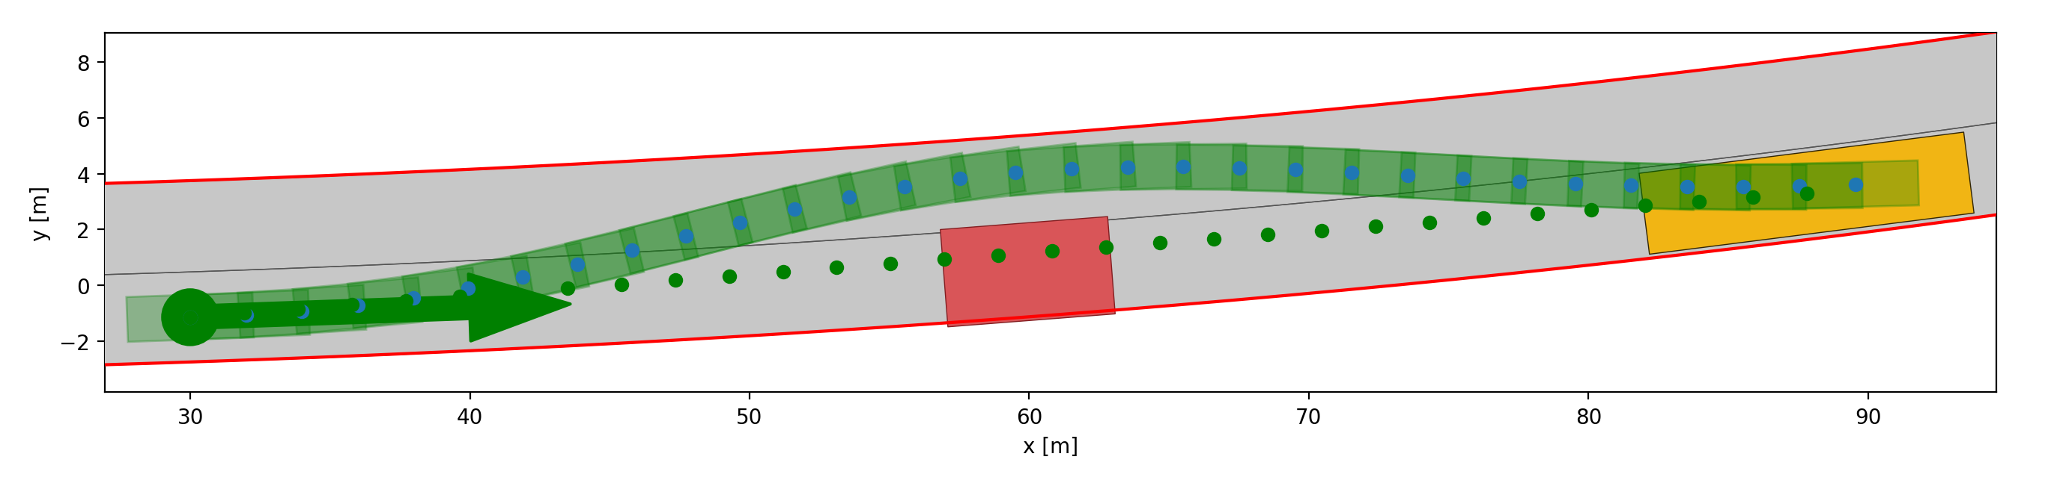
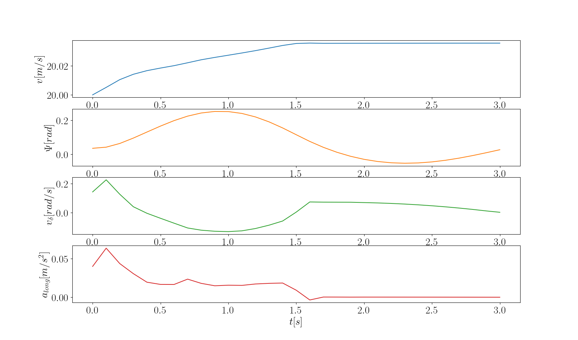
Experiments – CommonRoad[5]
$$F_{\left[0,T\right]}\left(reach goal\right)∧G_{\left[0,T\right]}(avoid collision)∧G_{\left[0,T\right]}(inside boundary)$$
Left boundary
Trajectory after optimization
Occupancy of the ego vehicle
Trajectory before optimization
Static obstacle
Goal region
Right boundary
Keep control
input small
[5] Althoff, Matthias, Markus Koschi, and Stefanie Manzinger. "CommonRoad: Composable benchmarks for motion planning on roads." 2017 IEEE Intelligent Vehicles Symposium (IV). IEEE, 2017.

Slide 19
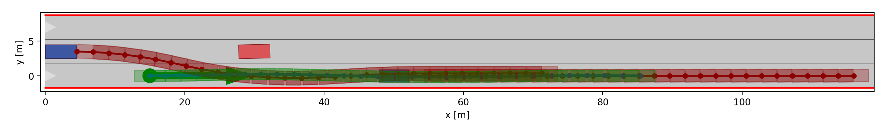
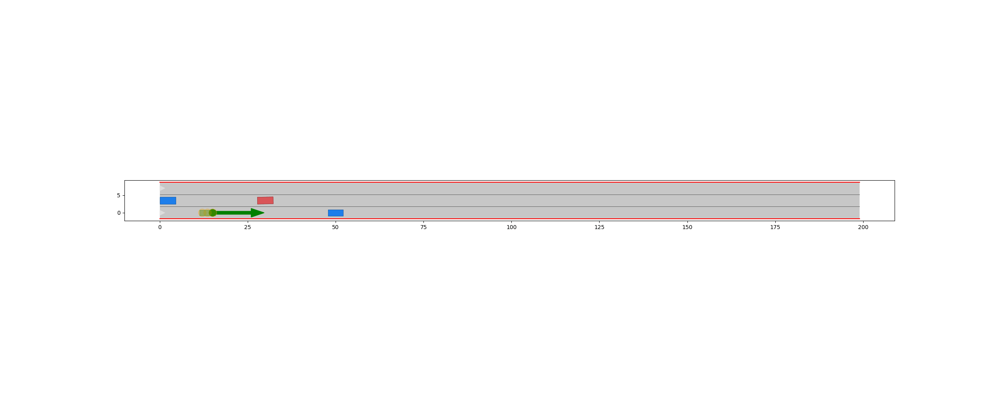
Experiments – CommonRoad
$$G_{\left[0,T\right]}(avoid collision)∧G_{\left[0,T\right]}(inside boundary)$$
Left boundary
Occupancy of the dynamic obstacles
Static obstacle
Right boundary
Occupancy of the ego vehicle

Slide 20
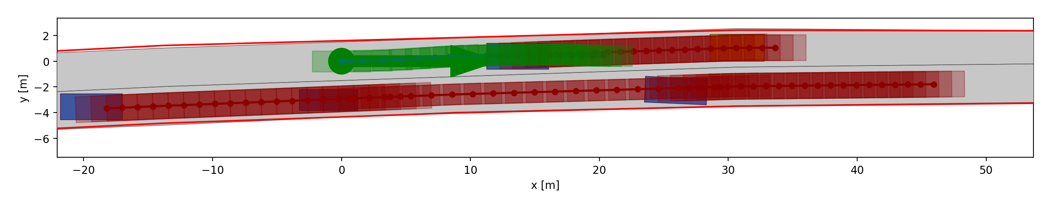
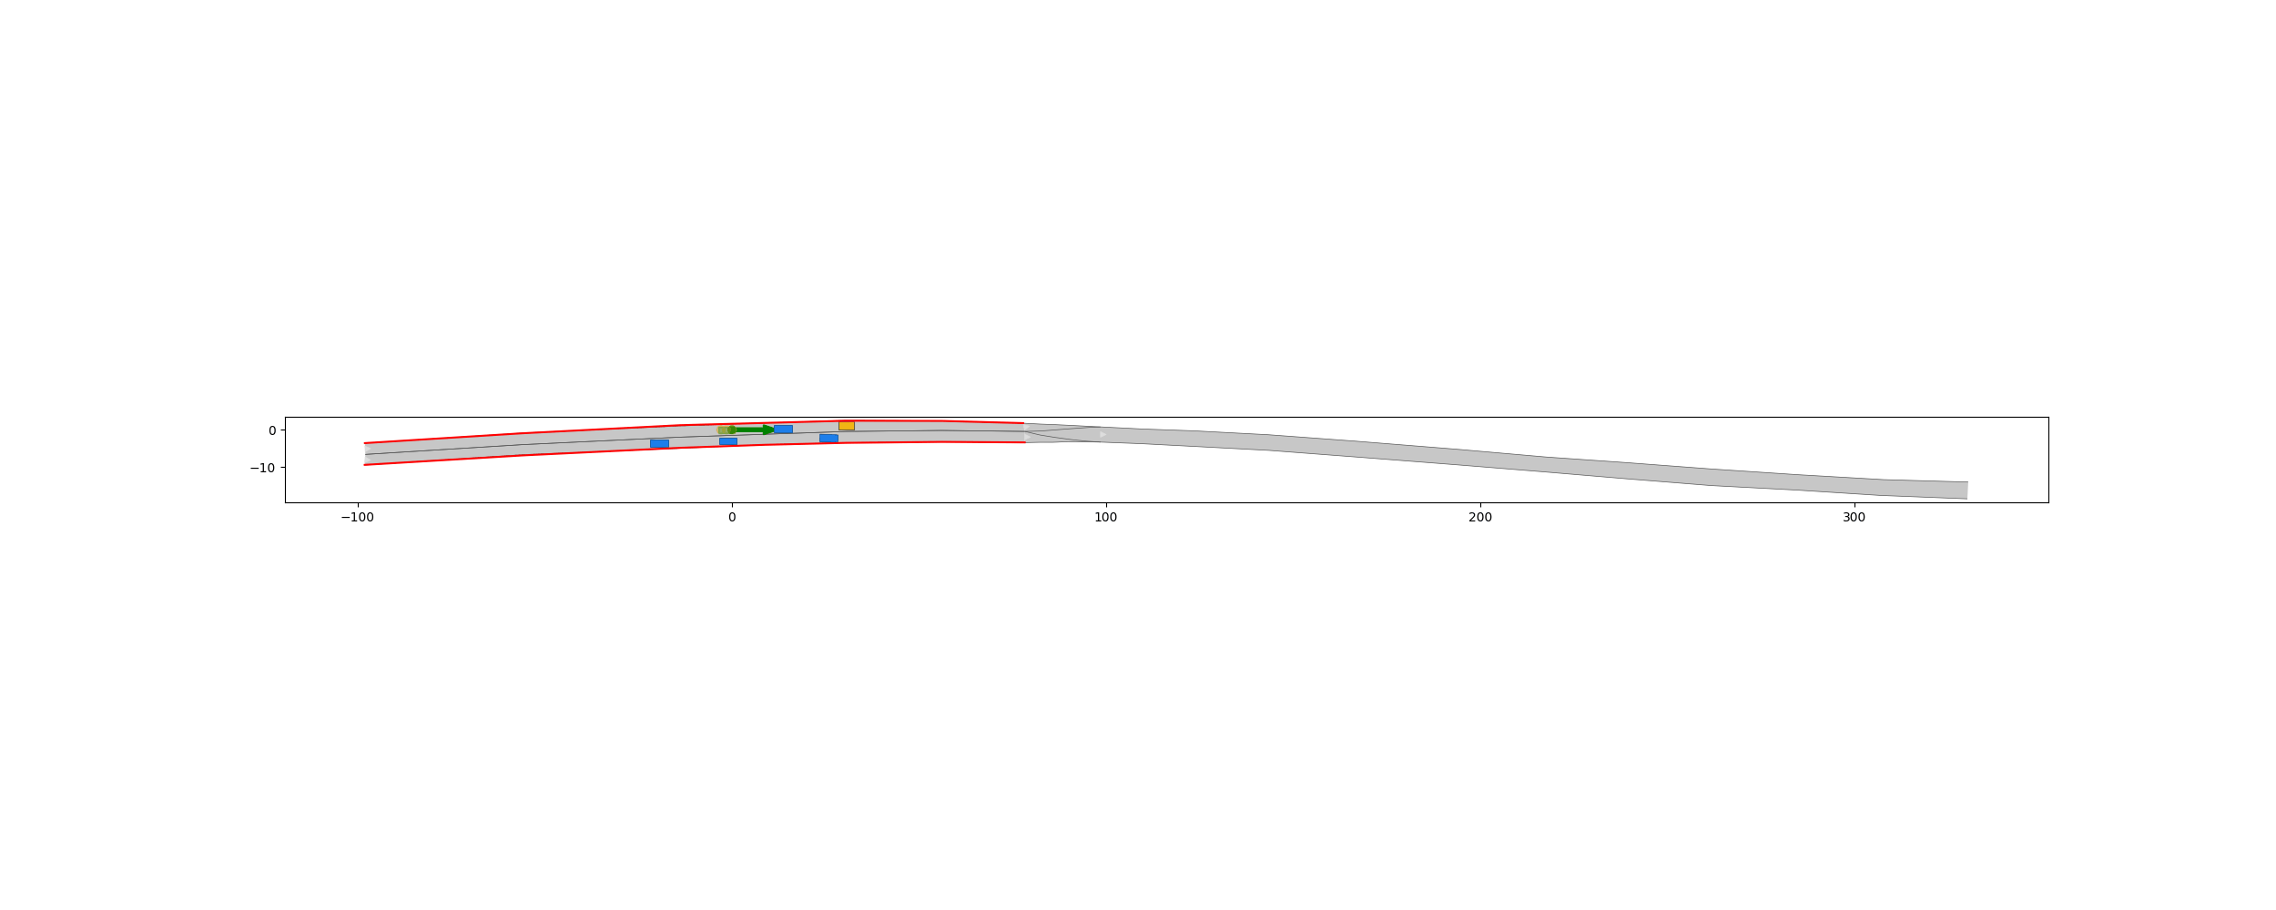
Experiments – CommonRoad
$$G_{\left[0,T\right]}\left(avoid collision\right)∧G_{\left[0,T\right]}\left(inside boundary\right)∧G_{\left[0,T\right]}\left(keep distance from the front vehicle\right)∧G_{\left[0,T\right]}\left(adhere to the speed limit\right)$$
Occupancy of the ego vehicle
Keep distance
Left boundary
Undesired drift to the right
Right boundary
Occupancy of the dynamic obstacles

Slide 21
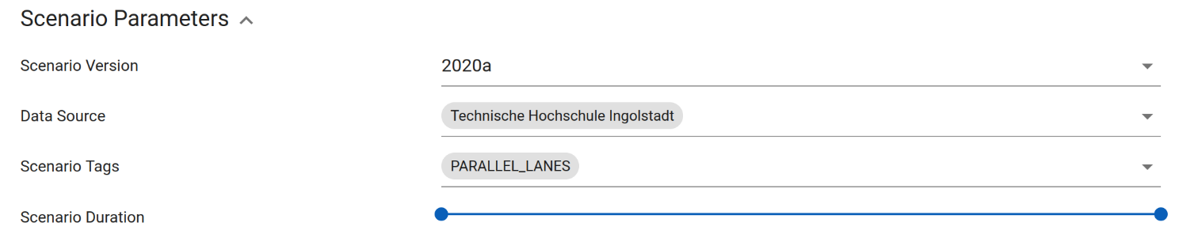
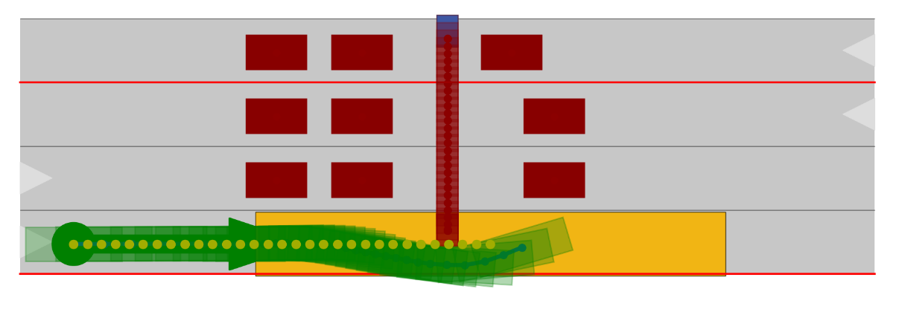
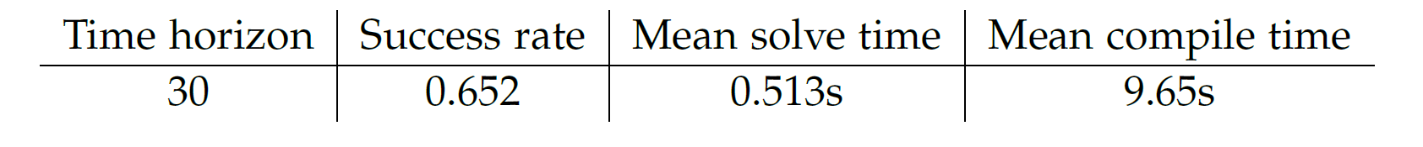
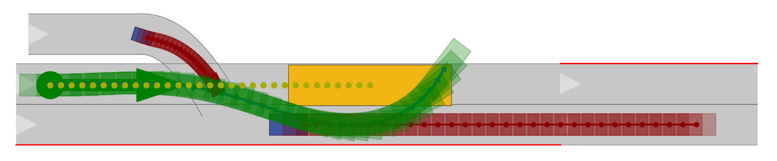
Experiments – CommonRoad
The result in 23 scenarios:
Initial guess
Occupancy of the ego vehicle
Occupancy of the ego vehicle
Failure cases:
The boundary is falsely added.
A bad initial guess can lead to an infeasible solution.
Initial guess

Slide 22
Summary
For the efficient optimization-based motion planning we used:
Signal Temporal Logic to represent complex traffic rules;
hybrid encoding method to transform the STL formula into iterative form;
Successive Convexification to guarantee the real-time capability.
Our method
makes a trade-off between computational efficiency and solution optimality;
can obtain a local optimum.

Slide 23
Outlook
Reduce compile time
Use Rapidly-exploring random trees (RRT*) to obtain the initial guess

Slide 24
Thank you for your attention

